Slide 1
Ellipsoid Motion Planning: “Highway Roadmap” planner
Sipu Ruan

Slide 2
Motivations
Sample-based planners
PRM, RRT, and their variants
Efficient for high dimensional configuration space
Require “sample-check-keep/reject” processes; Always fail in “narrow passage” problems
Can we explicitly parameterize free space and sample from it to reduce
Number of collision-checking calculations
Number of samples that are discarded
Or even without any collision detection?
Deterministic planners using Poly-ellipsoids and Superquadrics to model the robots and environment
Simple math expressions for describing the shapes
Closed-form characterizations of Minkowski sums

Slide 3
Highway Roadmap planner
Separation of translations and rotations
Construct C-Layers (C-Slices)
Generation of C-Obstacles
Closed-form Minkowski sum/difference
Detection of collision-free space
“Raster-scan” process
Connections of collision-free vertices within one C-Layer
Expand the boundary of obstacles to form convex (trapezoidal) collision-free cells
Connections of vertices among different C-Layers
Concept of “Kinematics of Containment”
Finding feasible path from start to goal
Graph search algorithms: Dijkstra, A*, etc

Slide 4
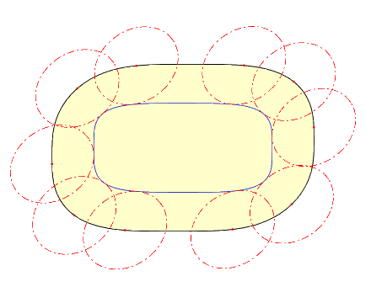
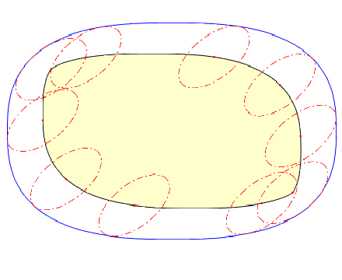
Minkowski Sum/Difference
In general,

Slide 5
Closed-form Minkowski Sum/Difference
Y. Yan, G S. Chirikjian. Closed-form characterization of the Minkowski sum and difference of two ellipsoids. Geom Dedicata (2015) 177:103–128
Ellipsoid-Ellipsoid:
Expressions:
Shrinking:
Offset surface:
Surface normal:
Transform back:

Slide 6
Closed-form Minkowski Sum/Difference
Ellipsoid-Superquadrics:
Superquadrics:
2D:
3D:

Slide 7
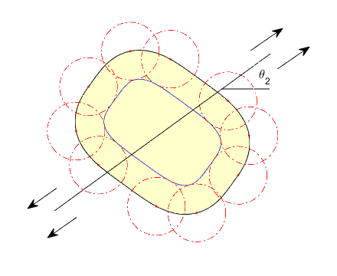
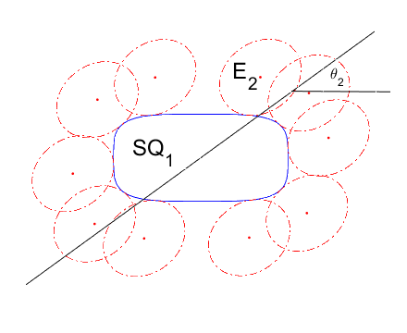
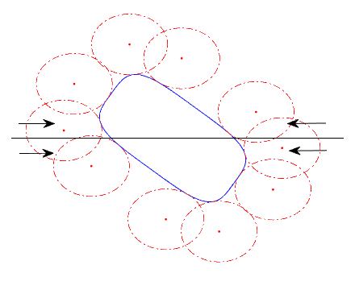
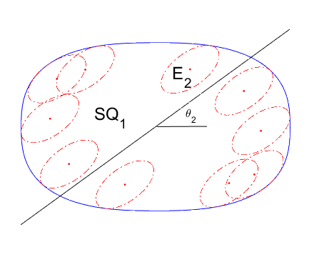
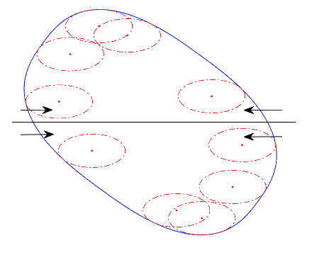
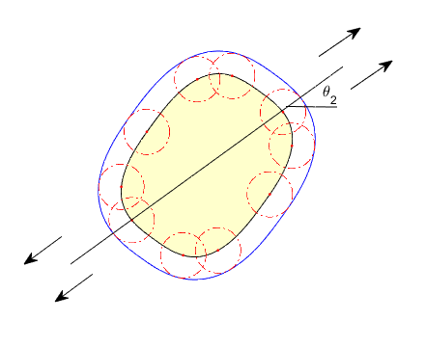

Slide 8
Highway Roadmap planner
Separation of translations and rotations
Construct C-Layers (C-Slices)
Generation of C-Obstacles
Closed-form Minkowski sum/difference
Detection of collision-free space
“Raster-scan” process
Connections of collision-free vertices within one C-Layer
Expand the boundary of obstacles to form convex (trapezoidal) collision-free cells
Connections of vertices among different C-Layers
Concept of “Kinematics of Containment”
Finding feasible path from start to goal
Graph search algorithms: Dijkstra, A*, etc

Slide 9
Raster scan process
Y. Yan, Q. Ma, and G S. Chirikjian, Path Planning Based on Closed-Form Characterization of Collision-Free Configuration-Spaces for Ellipsoidal Bodies, Obstacles, and Environments, RSS 2016
Generate collision-free line segments using set theory

Slide 10
Highway Roadmap planner
Separation of translations and rotations
Construct C-Layers (C-Slices)
Generation of C-Obstacles
Closed-form Minkowski sum/difference
Detection of collision-free space
“Raster-scan” process
Connections of collision-free vertices within one C-Layer
Expand the boundary of obstacles to form convex (trapezoidal) collision-free cells
Connections of vertices among different C-Layers
Concept of “Kinematics of Containment”
Finding feasible path from start to goal
Graph search algorithms: Dijkstra, A*, etc

Slide 11
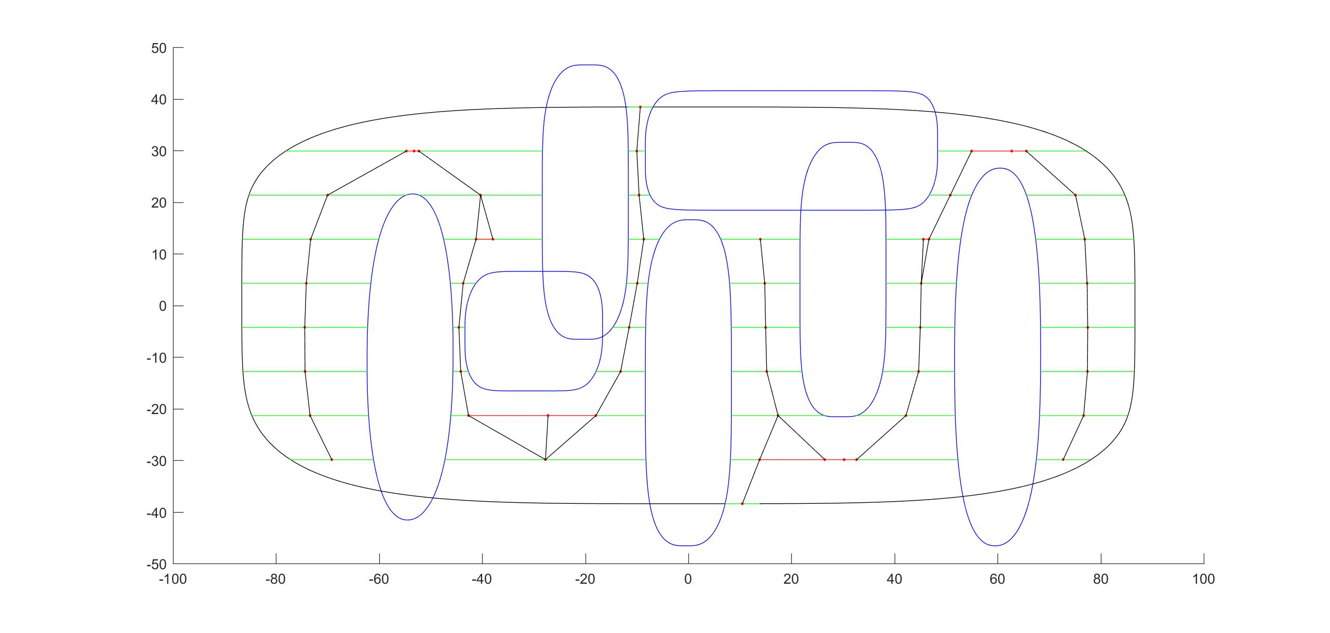
Connect vertices within one C-Layer
Conditions on collision-free cells

Slide 12
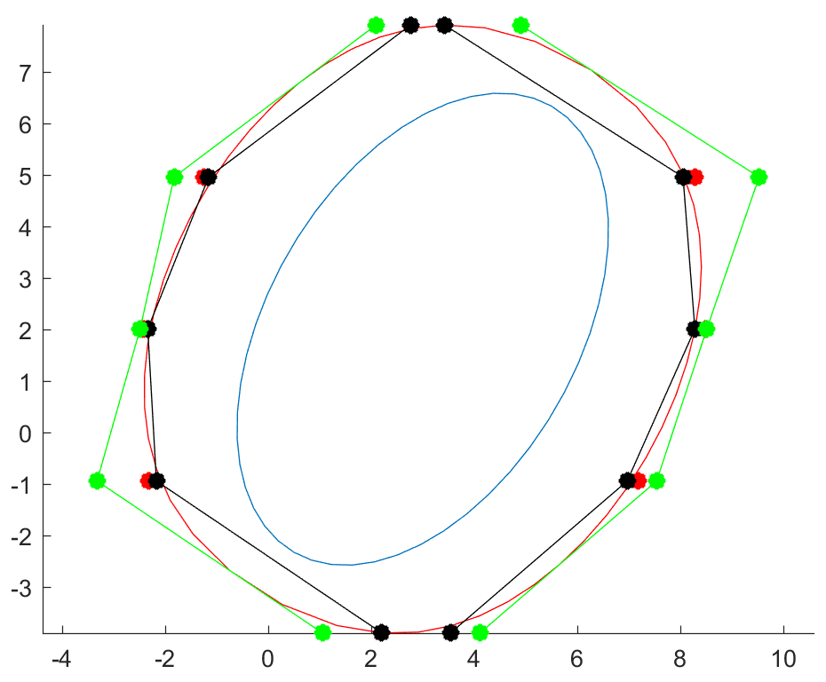
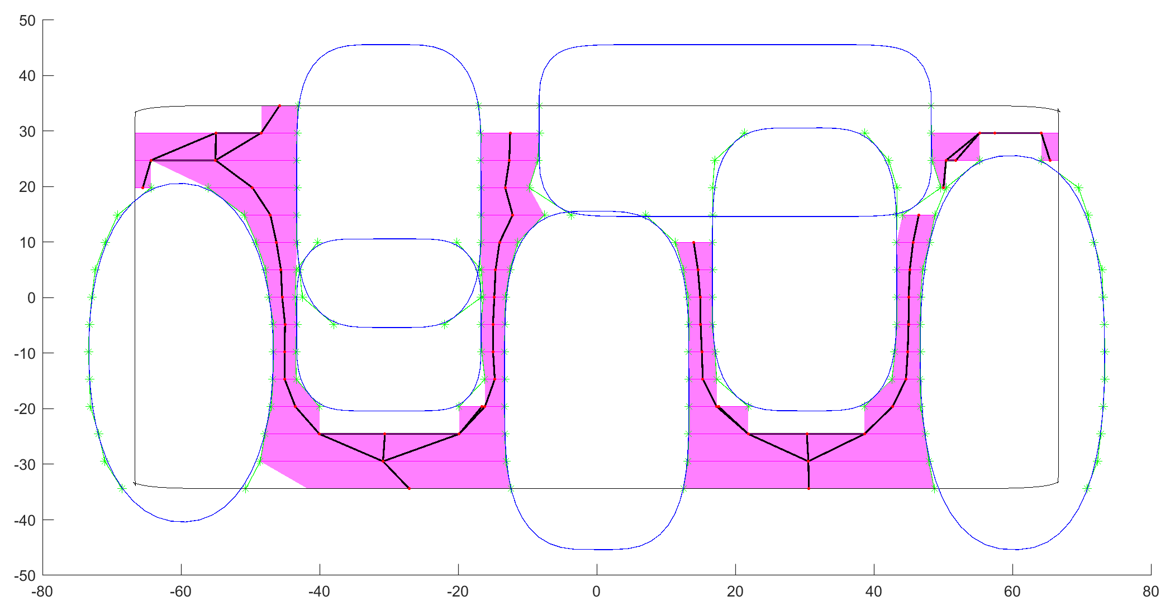
Connect vertices within one C-Layer
Finding tangent line segments that circumscribe the curved boundary by trigonometry

Slide 13
Highway Roadmap planner
Separation of translations and rotations
Construct C-Layers (C-Slices)
Generation of C-Obstacles
Closed-form Minkowski sum/difference
Detection of collision-free space
“Raster-scan” process
Connections of collision-free vertices within one C-Layer
Expand the boundary of obstacles to form convex (trapezoidal) collision-free cells
Connections of vertices among different C-Layers
Concept of “Kinematics of Containment”
Finding feasible path from start to goal
Graph search algorithms: Dijkstra, A*, etc

Slide 14
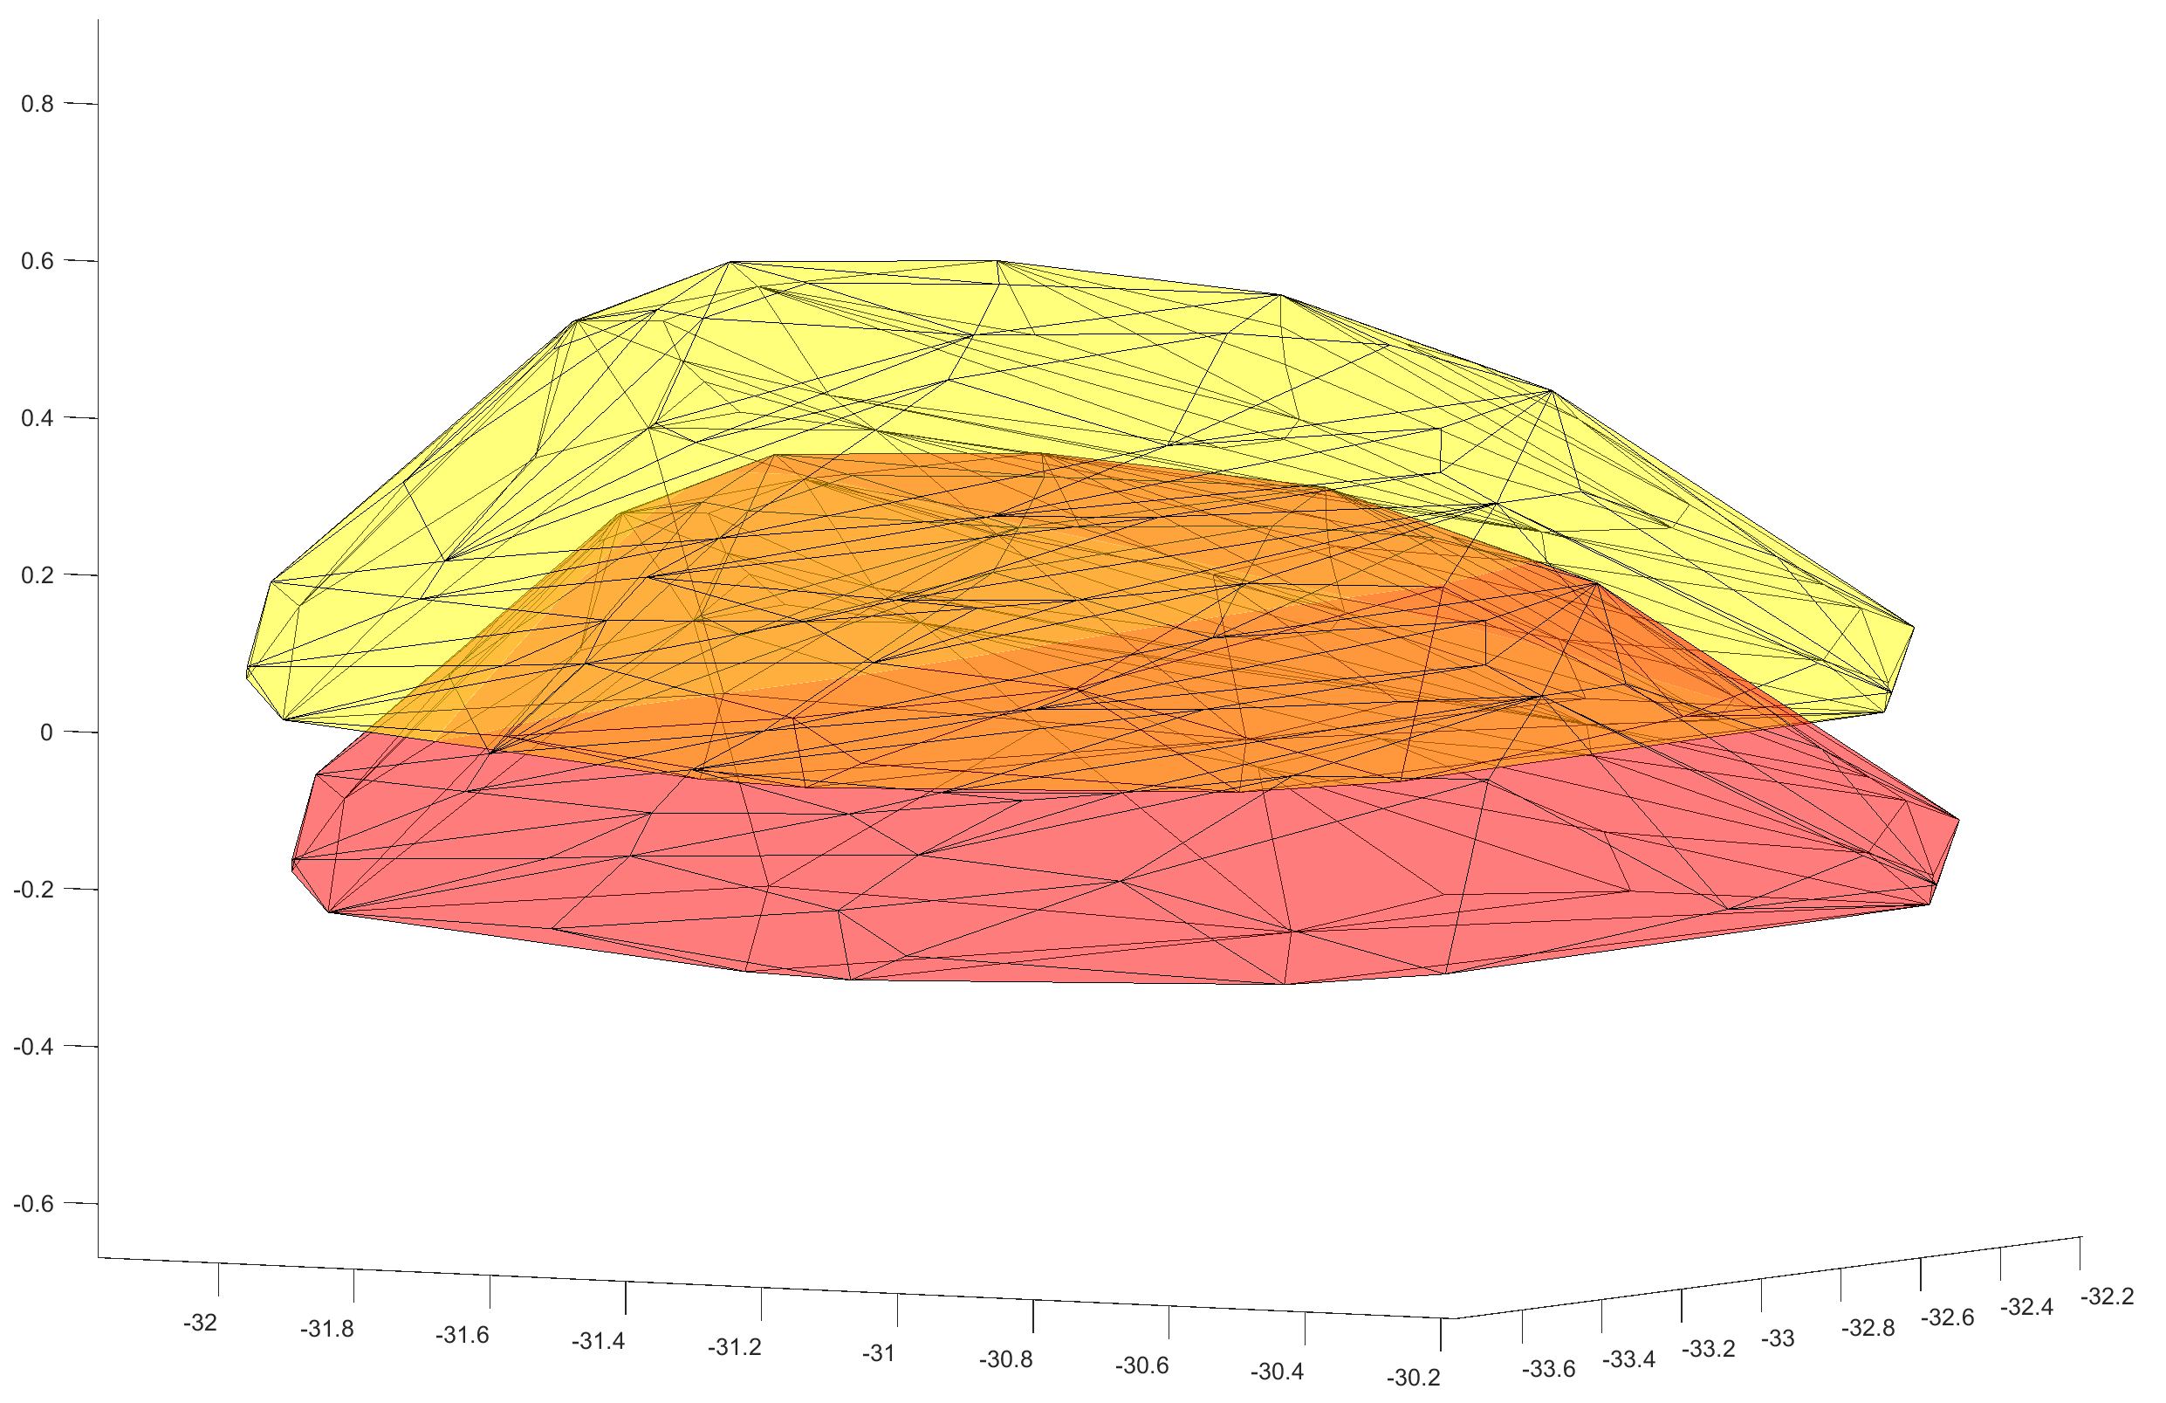
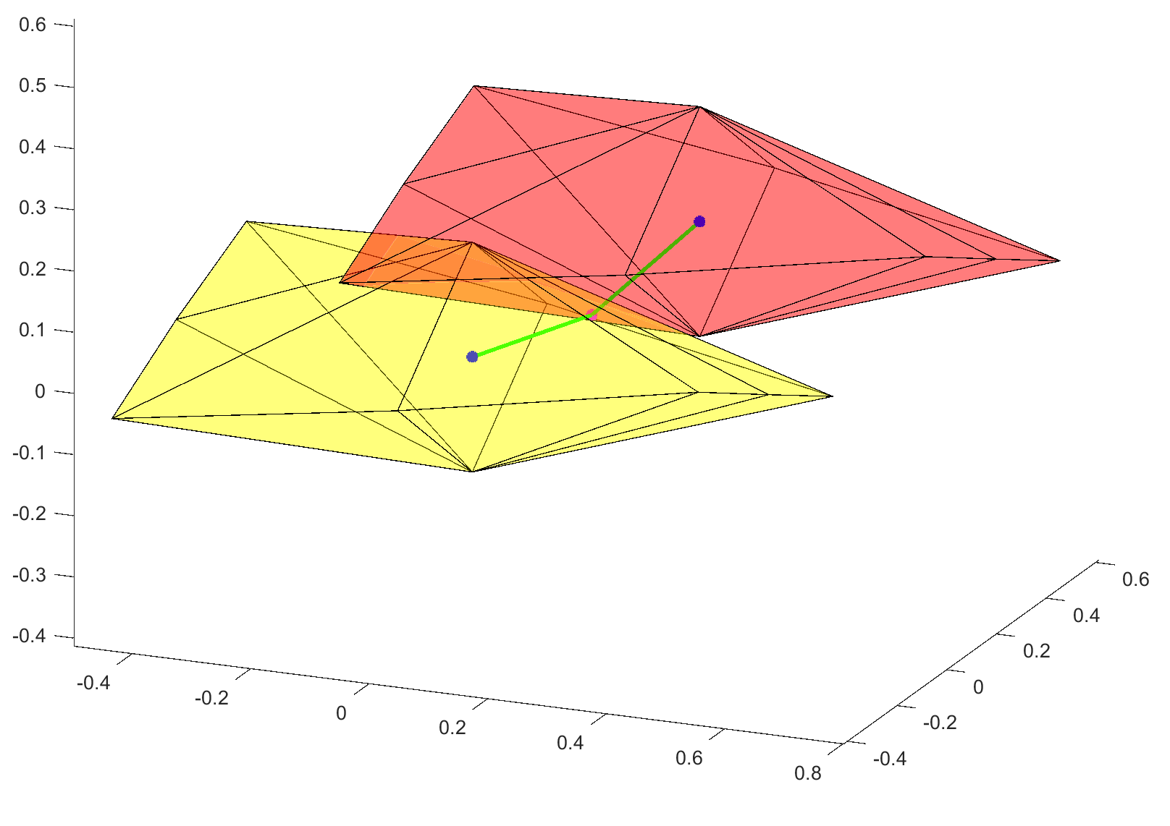
Kinematics of containment
Allowable motion of an ellipsoid inside a slightly larger ellipsoid
Find intersection of the two “local c-space” volumes

Slide 15
Kinematics of containment
Q. Ma, GS. Chirikjian. A CLOSED-FORM LOWER BOUND ON THE ALLOWABLE MOTION FOR AN ELLIPSOIDAL BODY AND ENVIRONMENT. ASME IDETC 2015
Closed-form lower bound of the KC volume
Problem to be solved:
Equivalent to:

Slide 16
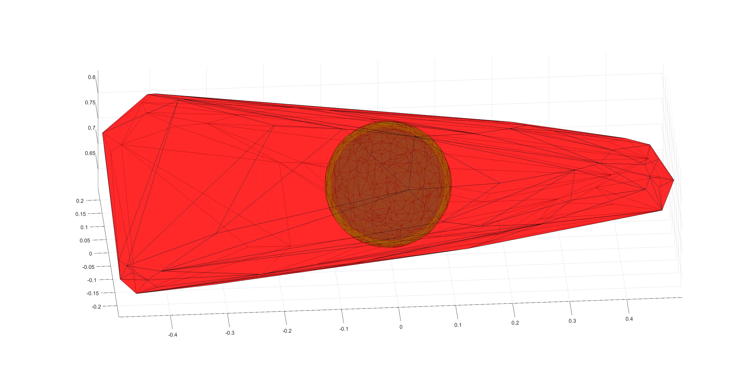
Kinematics of containment
Q. Ma, GS. Chirikjian. A CLOSED-FORM LOWER BOUND ON THE ALLOWABLE MOTION FOR AN ELLIPSOIDAL BODY AND ENVIRONMENT. ASME IDETC 2015

Slide 17
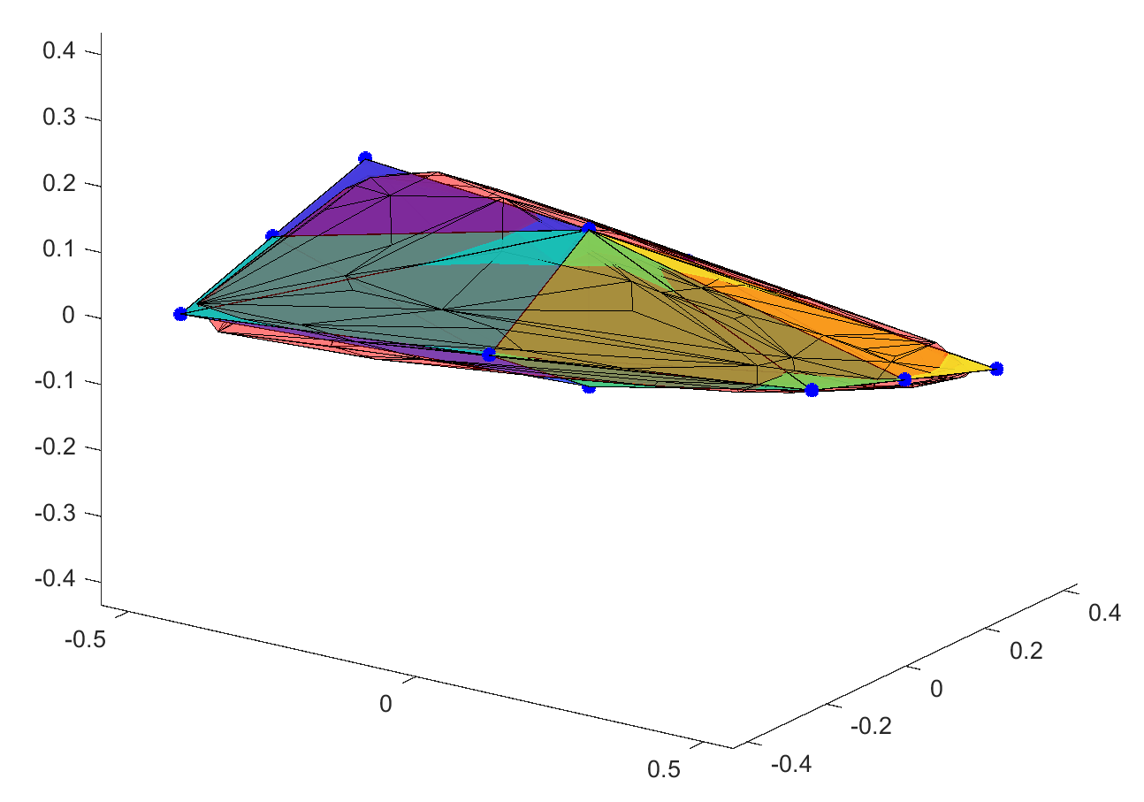
Kinematics of containment
Larger KC volume
Convex optimization to find extreme points
or equivaltently,
Other extreme points:
Fix one coordinate to be zero, compute extreme motion of the smaller ellipsoid

Slide 18
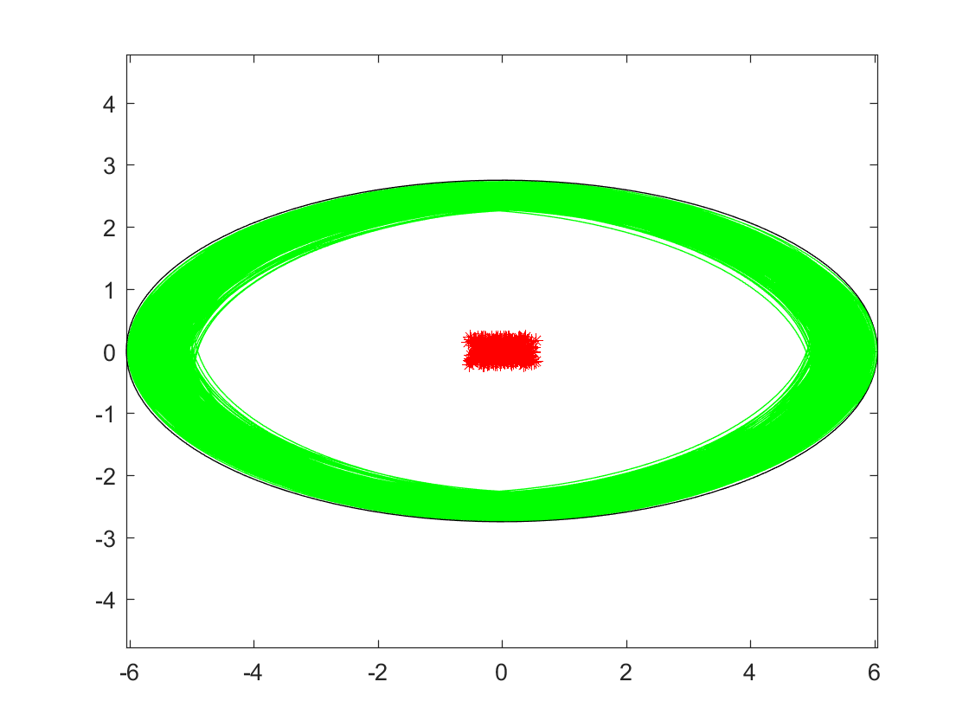
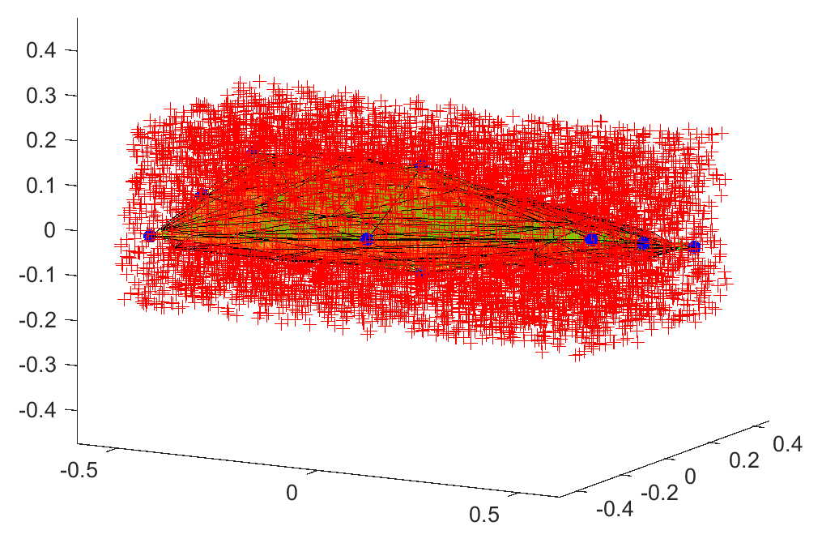
Kinematics of containment
Point-in-polyhedron test

Slide 19
Highway Roadmap planner
Separation of translations and rotations
Construct C-Layers (C-Slices)
Generation of C-Obstacles
Closed-form Minkowski sum/difference
Detection of collision-free space
“Raster-scan” process
Connections of collision-free vertices within one C-Layer
Expand the boundary of obstacles to form convex (trapezoidal) collision-free cells
Connections of vertices among different C-Layers
Concept of “Kinematics of Containment”
Finding feasible path from start to goal
Graph search algorithms: Dijkstra, A*, etc

Slide 20
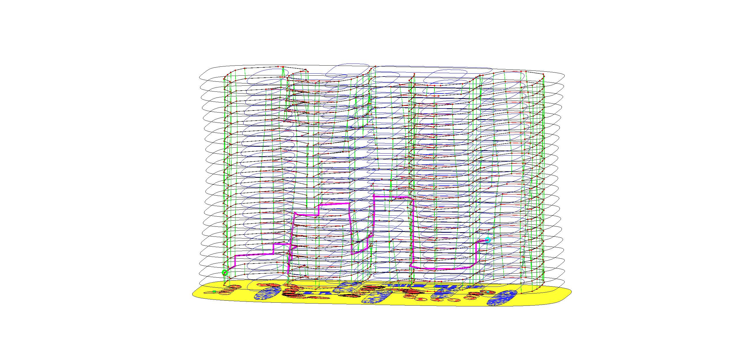
Roadmap and valid path

Slide 21
Future work
Compare with sample-based algorithms from popular motion planning library: OMPL
Hybrid method with sample-based planners
Extend to high dimensional C-Space

